Slide 1
MRI Parallel Imaging Review -
SENSE and GRAPPA
Group 16
Anooshirvan Mahdavian
Shreyaa Ramakrishnan
Nikhil Gandudi Suresh
Shinjini Das
Notes:
This is group 16,
We are going to have a review on mri parallel imaging especially on the 2 most important algorithms sense and grappa

Slide 2
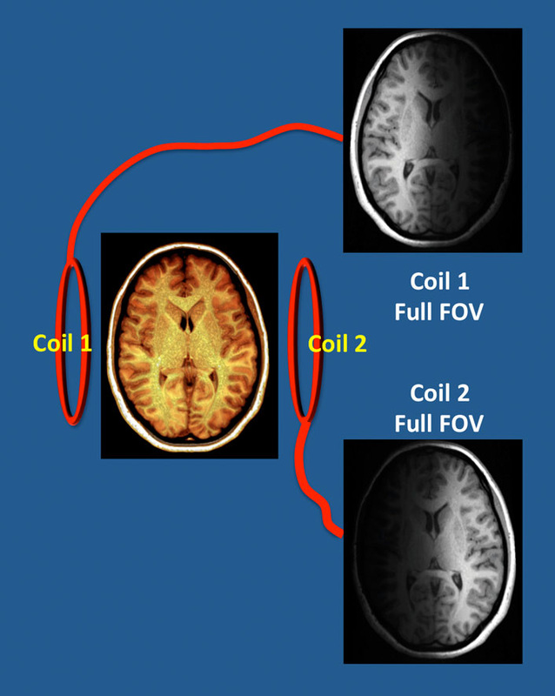
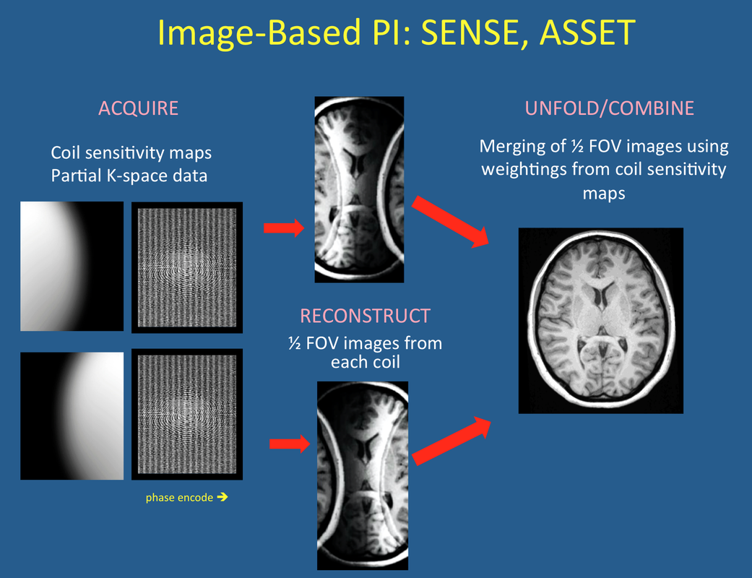
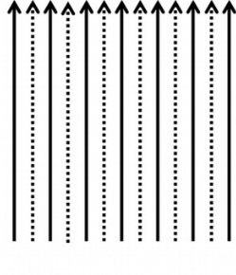
Introduction to Parallel Imaging
MRI is a slow imaging technique in compare with other methods such as CT
One method to speed up is parallel imaging, and undersampling
In order to reconstruct, we have sense base and grappa base methods.
Notes:
As we saw in the course, mri is a rather slow imaging technique in comparison with other techniques such as ct
And timing is important beyond the costs and expenses, for example in getting images from childs and babies or who afraid the mri tunnel.
So its desirable to speed up and one option could be the parallel imaging which mens use 2 or more coils instead of one coil to undersample and by this way do mri faster.
But we will face some problems like aliasing that we should do something for them

Slide 3
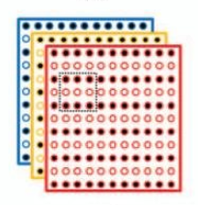
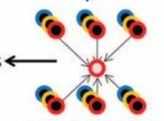
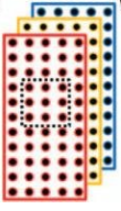
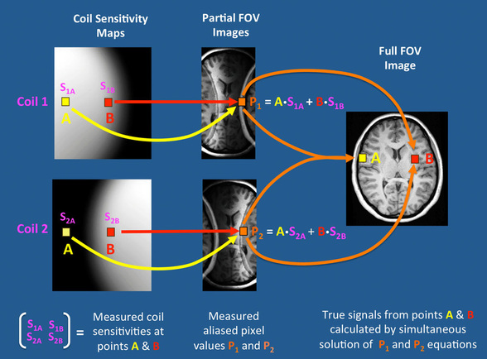
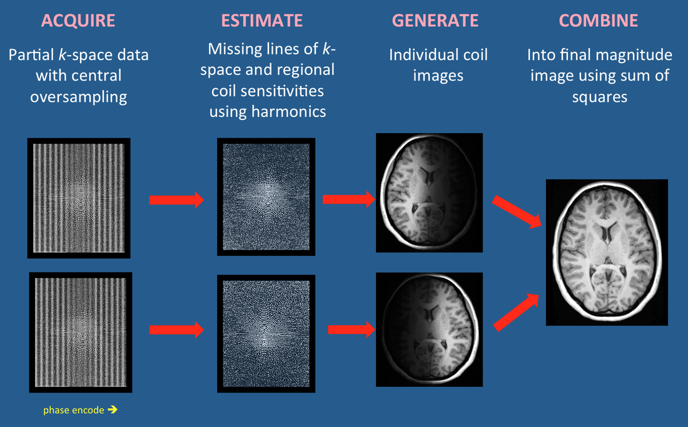
SENSE
vs.
GRAPPA
Notes:
The are 2 important algorithm that are the basis of parallel imaging. The sense and the grappa.
That in sense we use coil sensitivity profiles to find the undersampled rows. Means that we have the image in each pixel and we use the coils to solve a system of equations.
In contrast, instead of using the coil sensitivity maps we can sample completely in the center in order to figure out some weights factor to predict the remain k space. And then combine all coils images with sum of squares and get the final image.

Slide 4
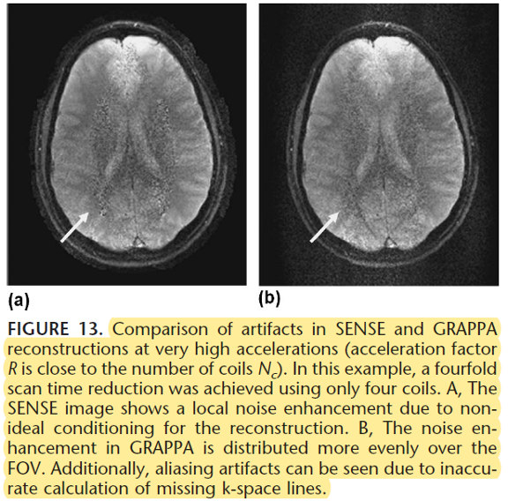
Advantages and disadvantages of SENSE and GRAPPA
Total imaging time. GRAPPA is a somewhat longer sequence than SENSE/ASSET because it requires extra time for the self-calibration of k-space lines.
Signal-to-noise. SENSE provides slightly higher SNR and better image quality as the acceleration factor is increased.
Body Region. SENSE does poorly in heterogenous body regions where accurate coil sensitivity maps may difficult to obtain (lungs)
Motion. SENSE may do poorly if motion occurs between the calibration and acquisition scans, resulting in reconstruction artifacts.
Field-of-view (FOV). GRAPPA is more tolerant toward small FOVs. SENSE/ASSET may produce aliasing/wraparound in the phase-encode direction if the full FOV is smaller than the imaged object.

Slide 5
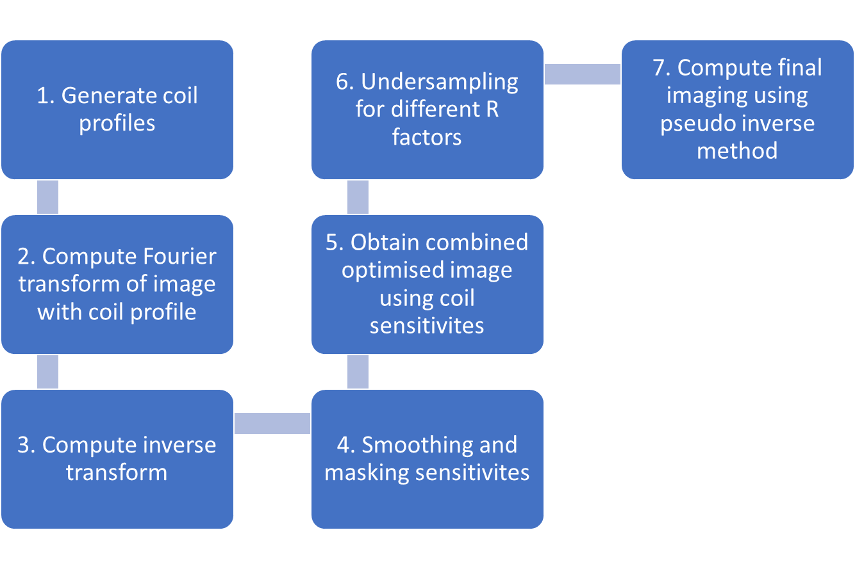

Model Setup
Image - Shepp-Logan Phantom
R-factors - [2, 3, 4, 6]
Number of coils - [4, 8, 16]
Two types of coil profiles - [Sigmoid, Gaussian]
MSE and SNR as the metrics
SENSE
GRAPPA

Slide 6
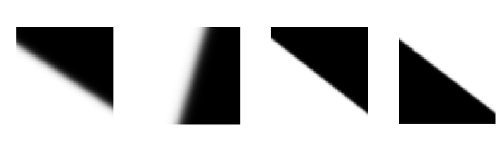
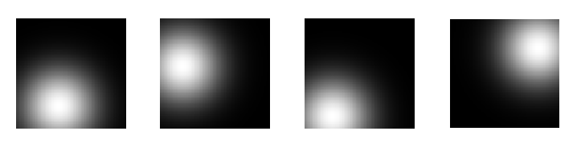
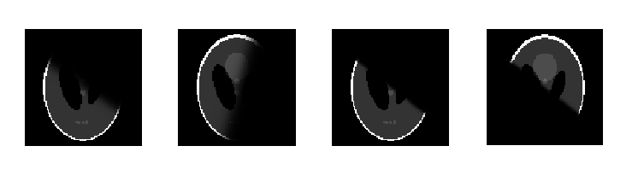

Coil Sensitivity Profiles
Type 0
Sigmoid Profiles
Type 1
Gaussian Profiles

Slide 7
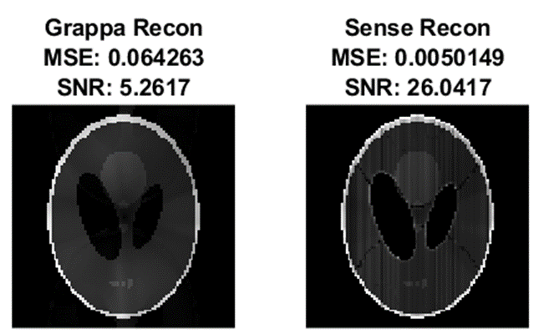
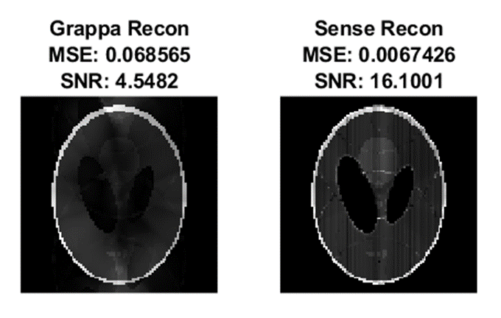
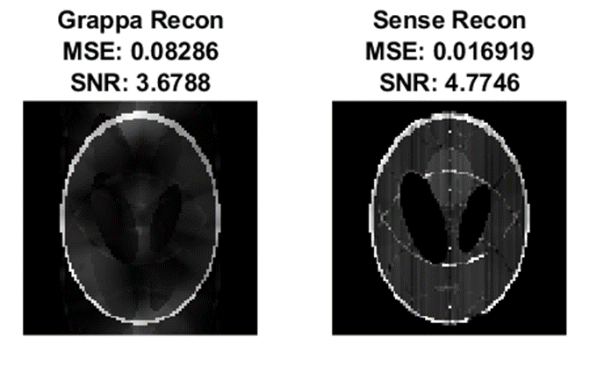
Varying R Value
R=2, 8 profiles
R=3, 8 profiles
R=4, 8 profiles

Slide 8
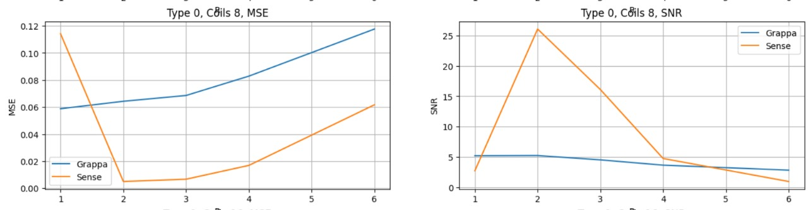
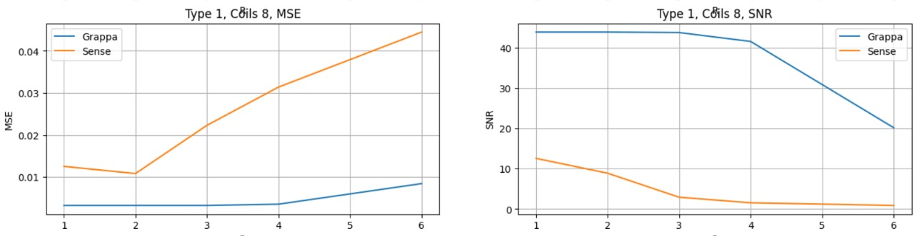

Slide 9
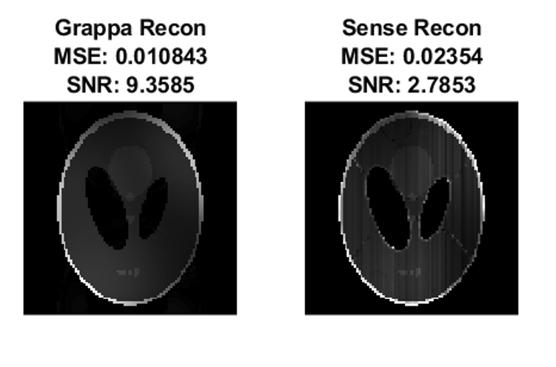
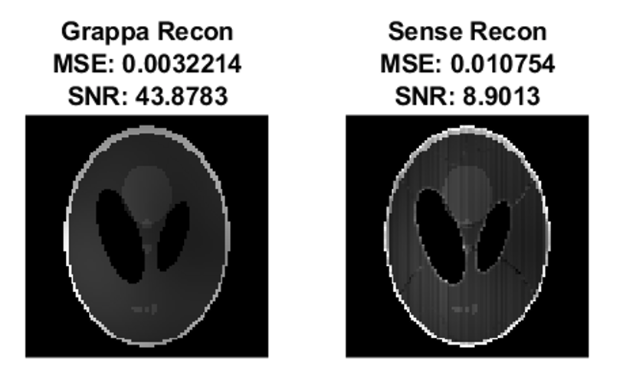
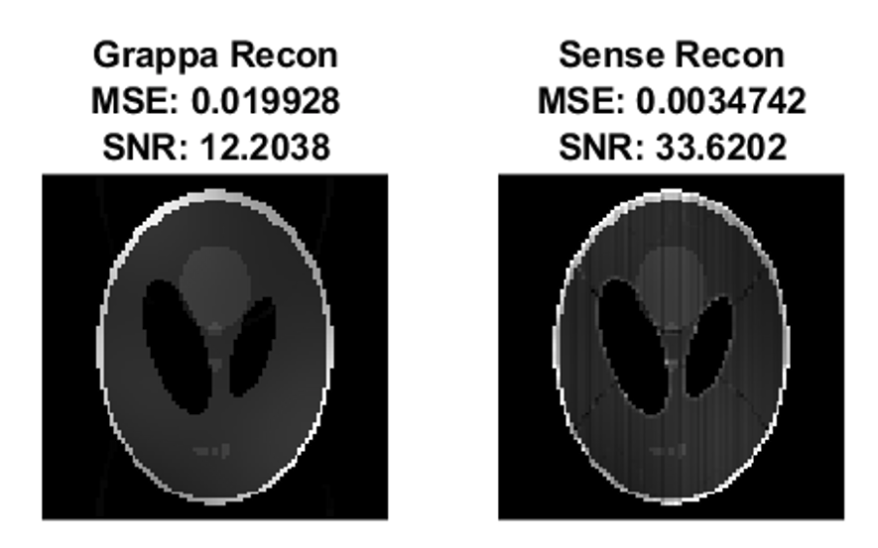
Varying Number of Coils
4 Coils, R=2
8 Coils, R=2
16 Coils, R=2

Slide 10
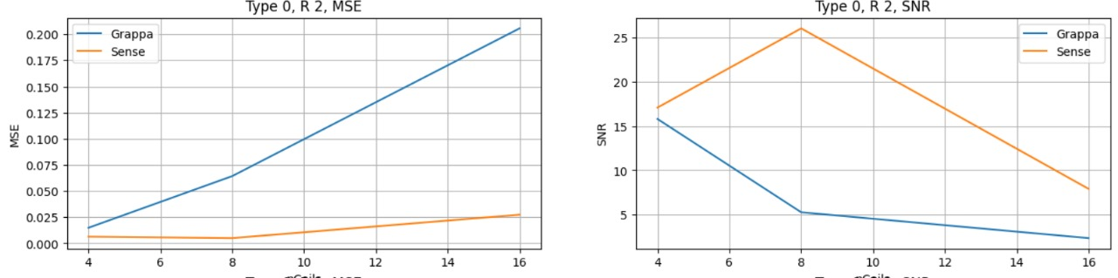
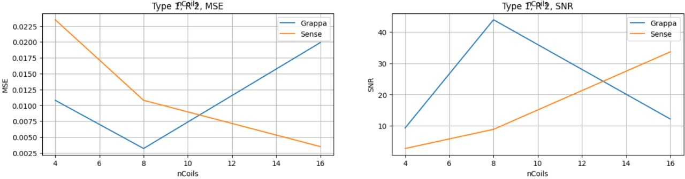

Slide 11




SIGMOID COIL PROFILES
GAUSSIAN COIL PROFILES
R=2
R=3
Notes:
We notice that grappa performs better than sense we use gaussian coil. This is because of the coil sensitivity profile in the k-space data.
The sigmoid’s FT is possibily just two points. And in just one direction.
Wheras the FT of Gaussian is a gaussian. More valid data points and that gives us robust recon.

Slide 12
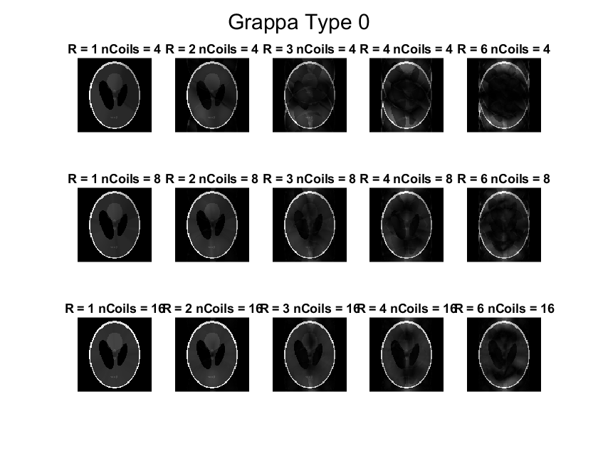
nCoils
R

Slide 13

nCoils
R

Slide 14
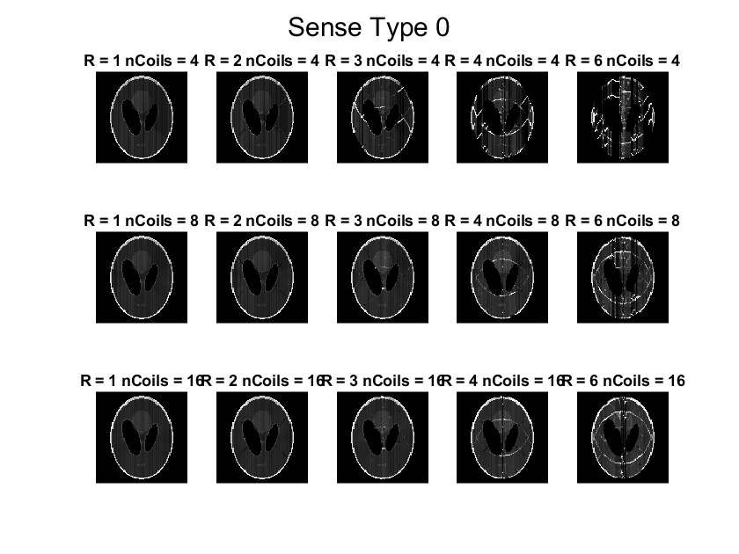
nCoils
R

Slide 15

nCoils
R

Slide 16
Observations
Increasing R-factor increases MSE and reduces SNR.
Increasing number of coils increased MSE and reduced SNR. Although, there seems to be a sweet spot for the number of coils. (8 in our case).
We observe aliasing artifacts in SENSE, while we observe the image getting cloudy in GRAPPA.
The above results are highly dependent on the sensitivity profiles of the coils.

Slide 17
References
Grappa and Sense Tutorial by Mark Chiew.
Blaimer M, Breuer F, Mueller M, Heidemann RM, Griswold MA, Jakob PM. SMASH, SENSE, PILS, GRAPPA: how to choose the optimal method. Top Magn Reson Imaging. 2004 Aug;15(4):223-36. doi:https://doi.org/10.1097/01.rmr.0000136558.09801.dd
Parallel MR Imaging https://doi.org/10.1002/jmri.23639
SENSE/ASSET? - Questions and Answers ​in MRI (mriquestions.com)
GRAPPA/ARC? - Questions and Answers ​in MRI (mriquestions.com)

Slide 18
Thank You

Slide 19
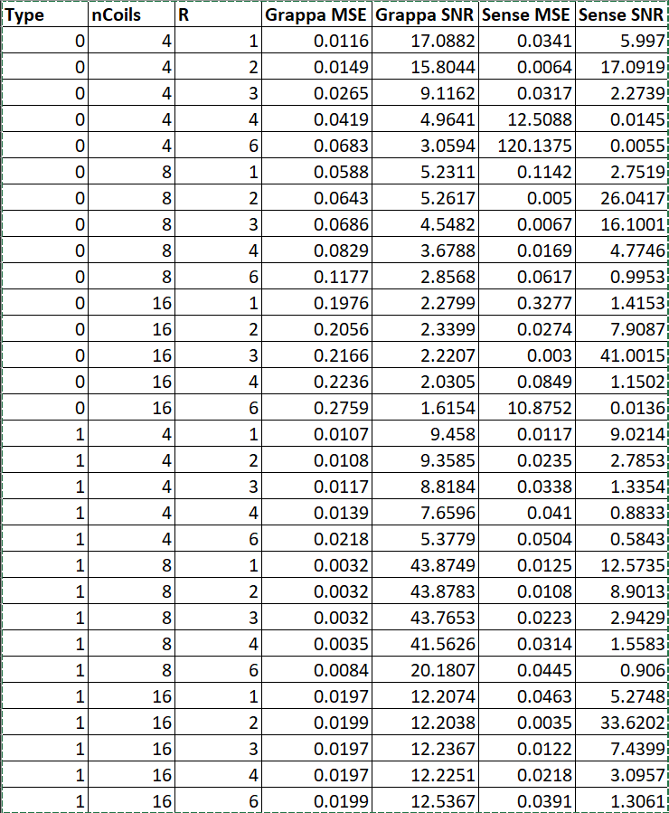
Appendix

